Slide 1
STATEWIDE MEETING
May 10, 2025

Slide 2
WELCOME!

Slide 3
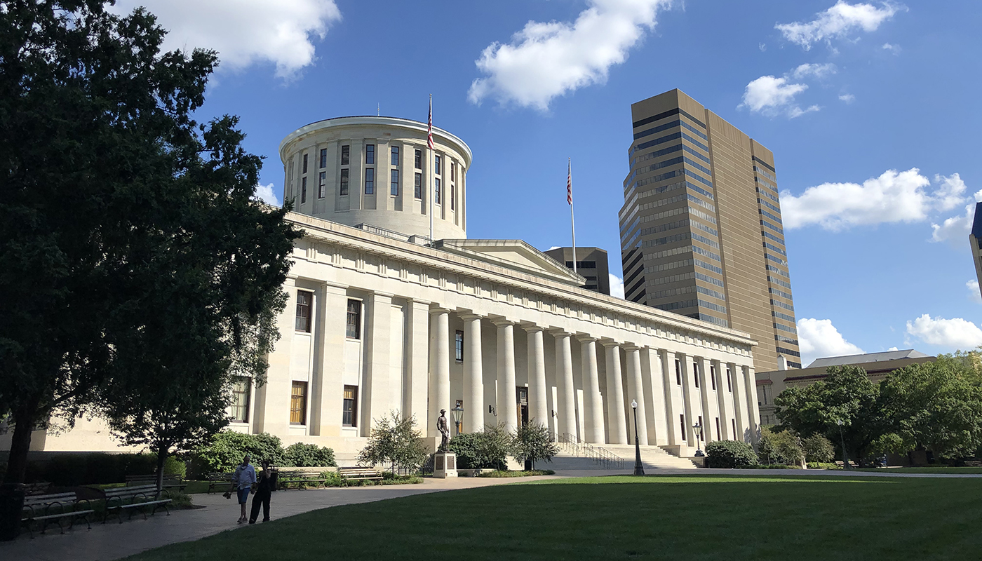
Long Range Transportation Plans
2050 will be here before you know it

Slide 4
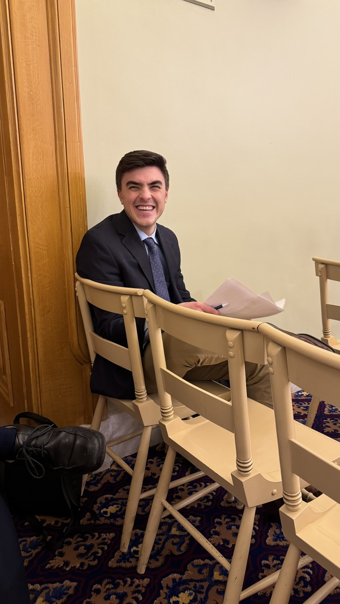
Mitch Radakovich
Board Chair
Cincinnati, OH

Slide 5
What is Long Range Planning?

Slide 6
Long Range Planning
Federal law: Each state must prepare a plan providing for the development and implementation of the multimodal transportation system, including transit, highway, bicycle, pedestrian and accessible transportation over a 20+ year planning horizon

Slide 7
Long Range Planning
Strategic
Guides shorter-term plans and projects
Prescriptive
What needs to be true to achieve strategic goals
Forward thinking
What is the trajectory of Ohio?
What do we want it to be?

Slide 8
Long Range Planning?
Projects
Depends on project scope
3C+D =/= Long Range Planning
3C+D achieves goals of long range planning

Slide 9
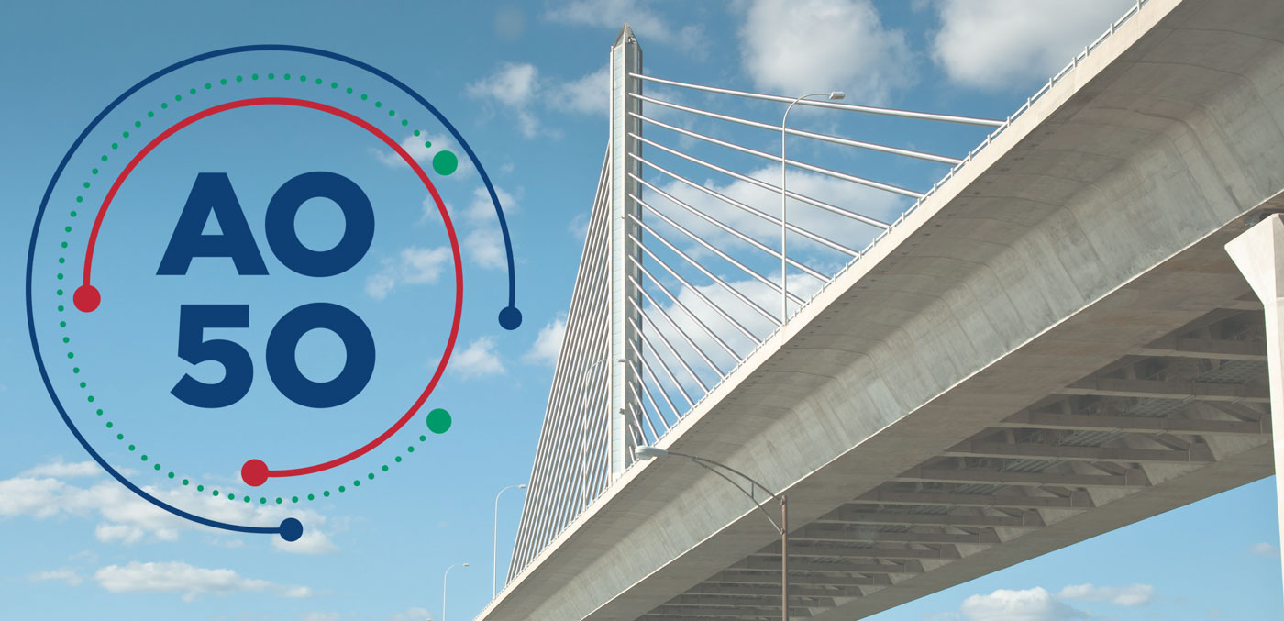
Access Ohio

Slide 10
Mission
“Access Ohio guides, informs, and supports ODOT’s strategic direction by analyzing Ohio’s existing and future transportation needs, system conditions and performance.
Access Ohio informs strategic policy, informs capital investment decisions and supports advancement of ODOT’s mission and vision.”

Slide 12
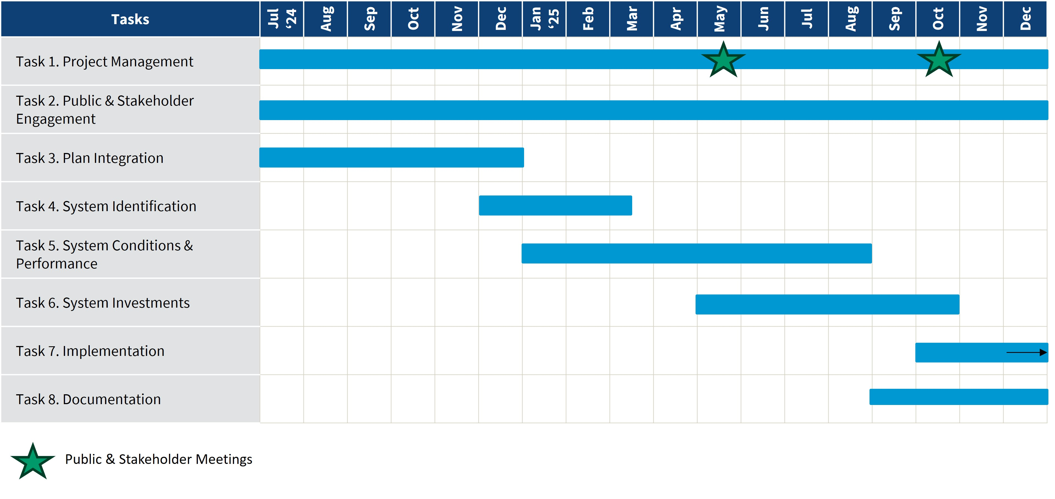

Slide 13
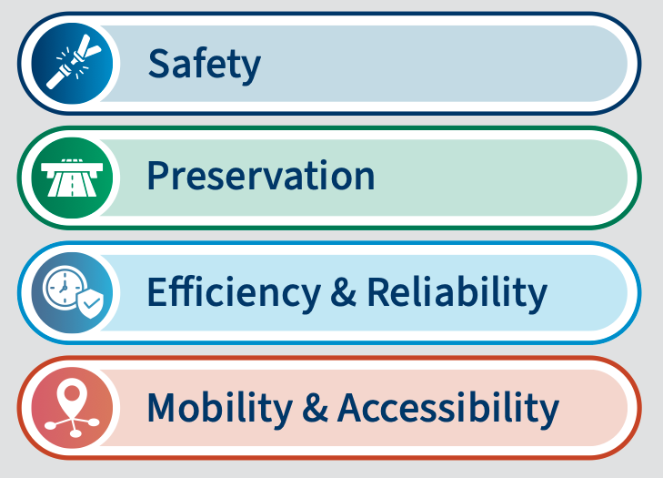
ODOT Draft Goals
Based on review of state, regional and local plans
Refined through stakeholder and public input

Slide 14
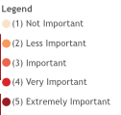
ODOT Transportation Survey

Slide 15
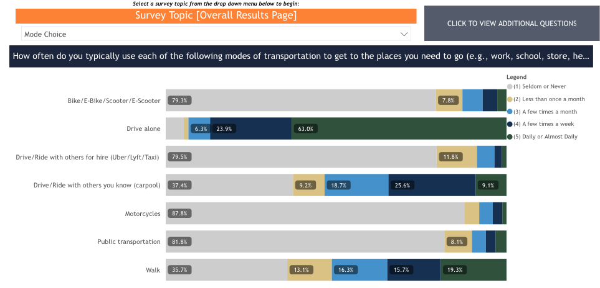
ODOT Transportation Survey

Slide 16
AAO’s Goals

Slide 17
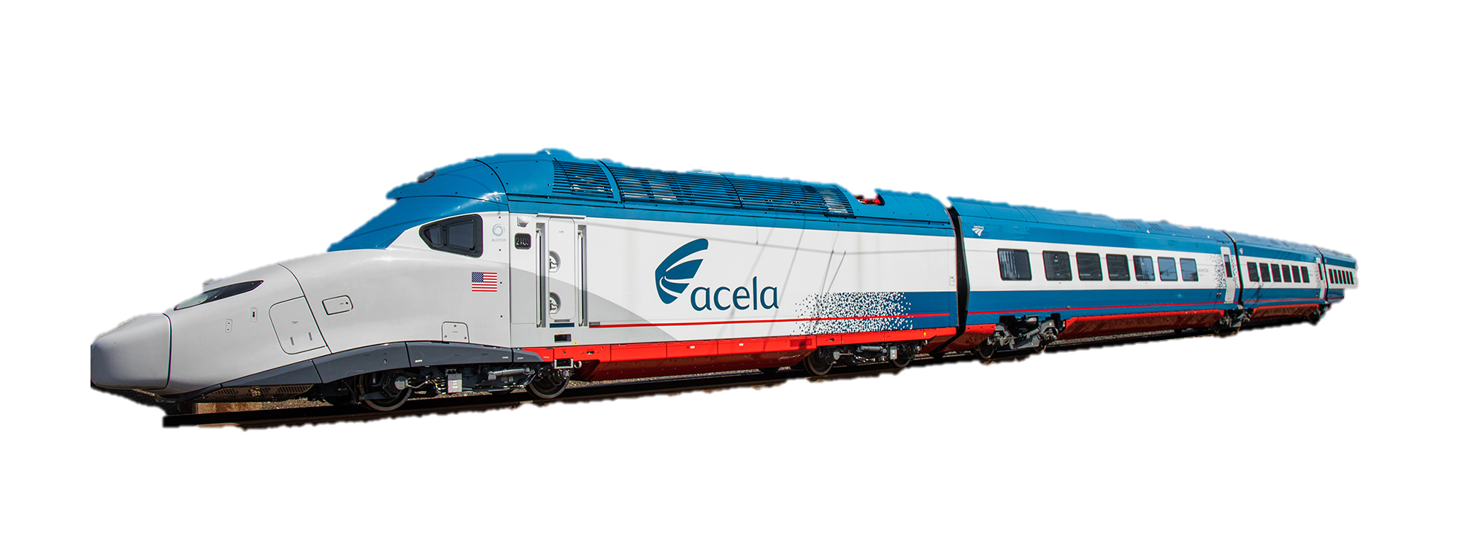

Slide 18
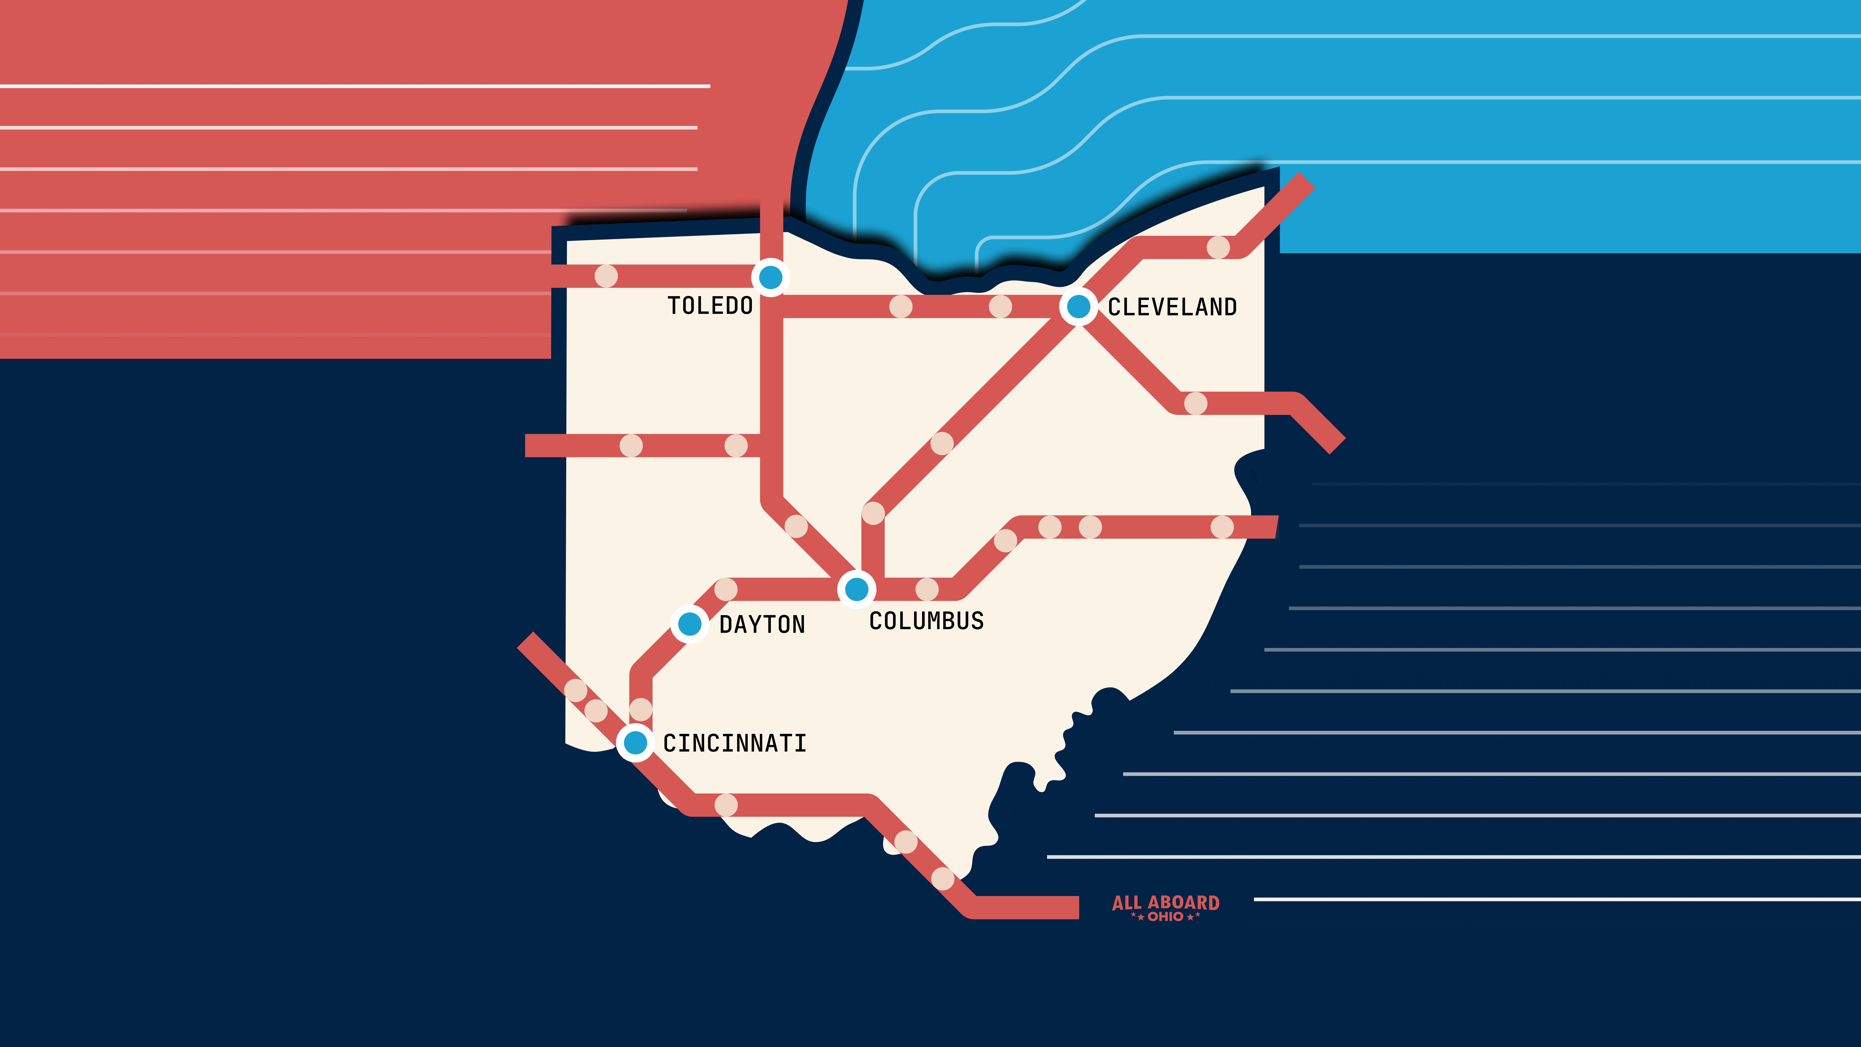
AAO Long-Term Priorities
Intercity rail connectivity
Improvements to regional bus network
Amtrak Thruway, Greyhound, Megabus (??)
Bike + Pedestrian safety in our cities & towns
Support for local transit agencies

Slide 19
AAO Long-Term Priorities
Policies to change public perception on transportation
Make busses approachable
Development practices to support high-density transportationt

Slide 20
Action Requested!

Slide 22
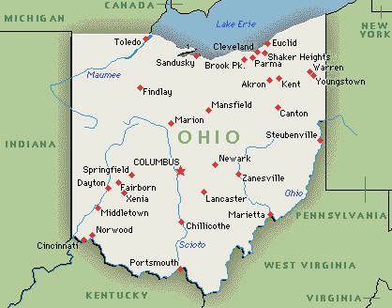

Slide 23
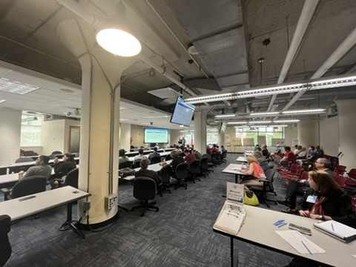
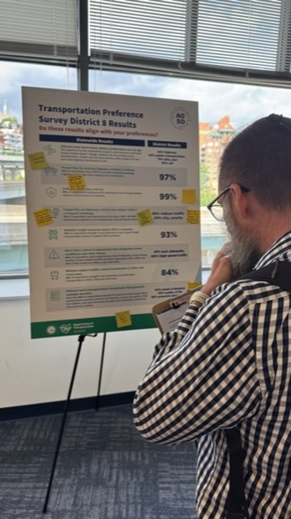
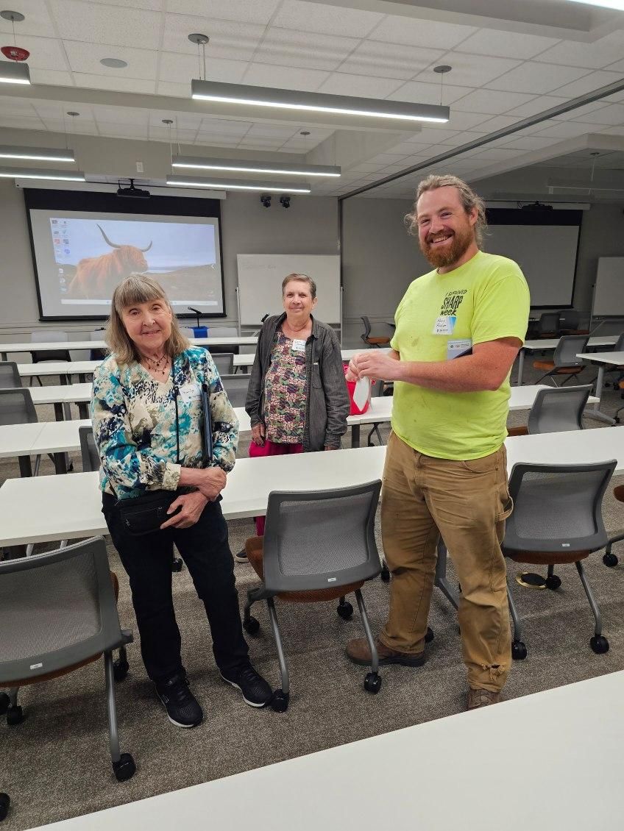
Format
30 Min Open House
30 Min Presentation
30 Min Q&A
Talk with Statewide Project Leaders!
NO Public Speaking Required

Slide 24
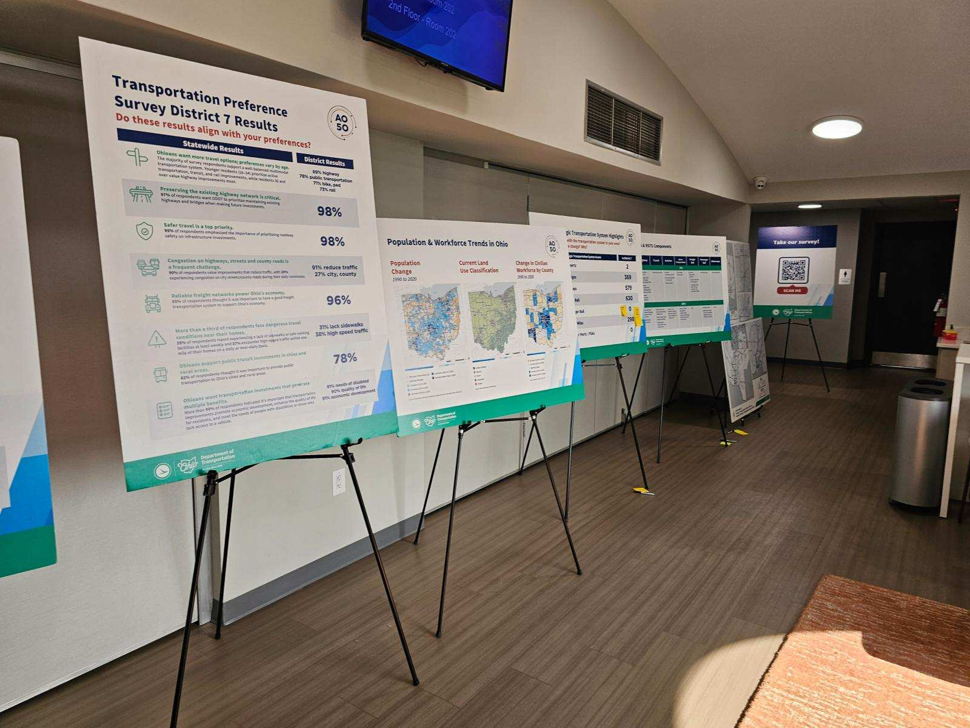
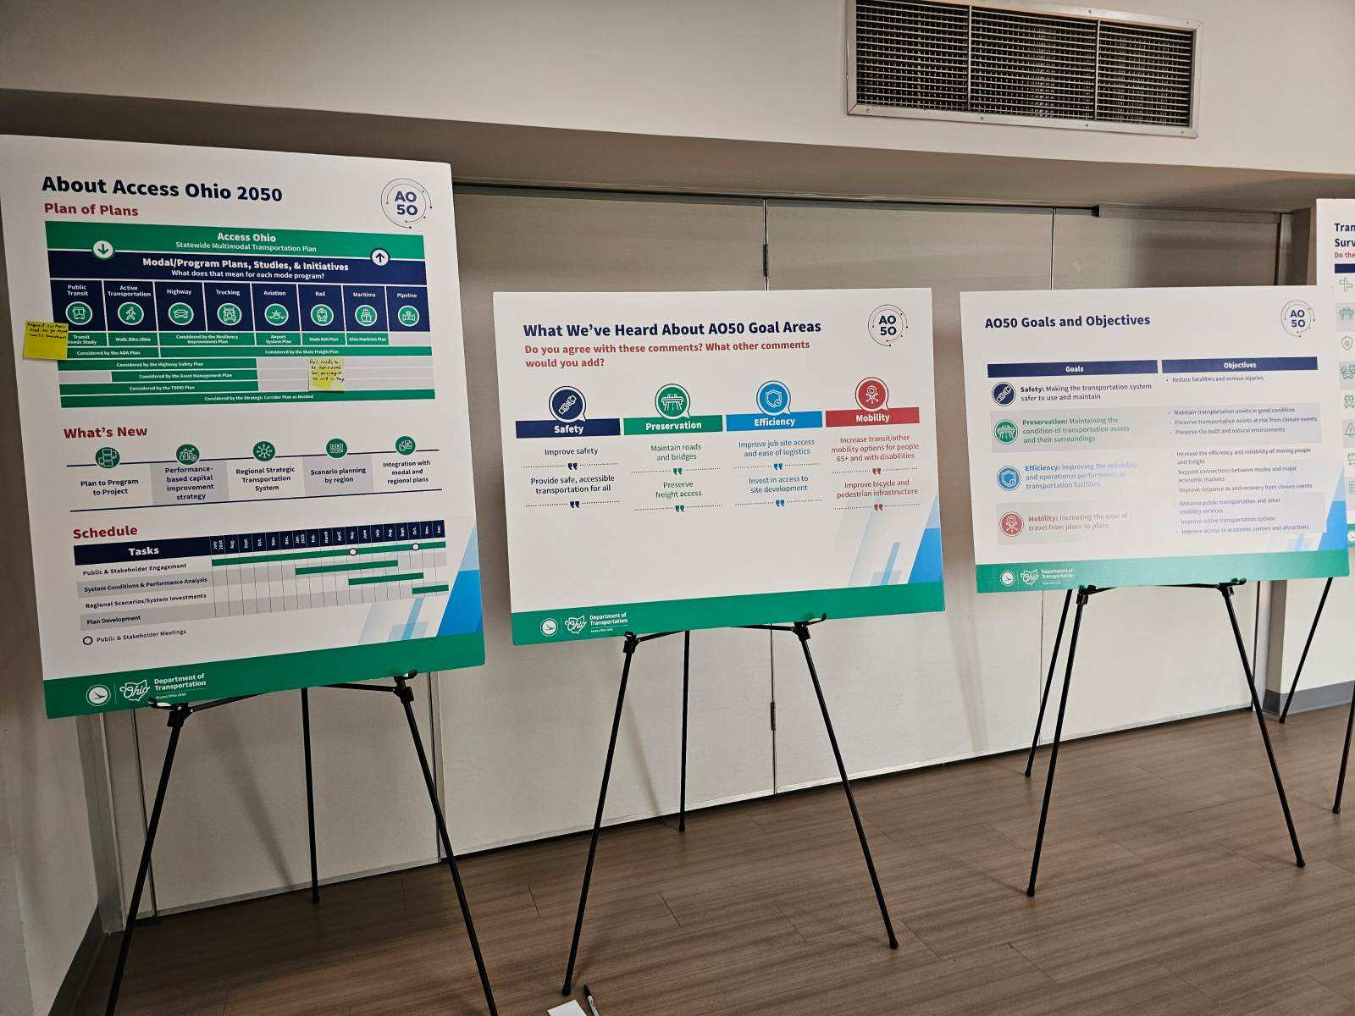
Open House

Slide 25
Why is this Important?
One of a few opportunities for public input
Providing new perspectives to planning process
Ohio transportation echo chamber

Slide 26
Why is this Important?
Opportunity for AAO to show we are STATEWIDE
Goal: Representation at all 12 events

Slide 27
Call To Action
Attend your local event!
Invite (and pressure ☺) sympathetic friends
Pass along to people in:
Zanesville
Marietta
Youngstown
Ironton, OH / Huntington, WV

Slide 28
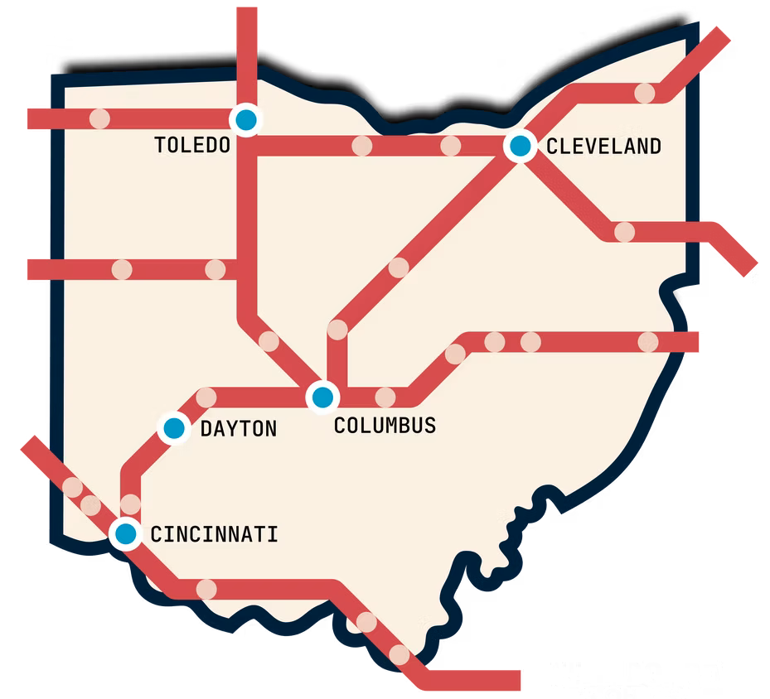
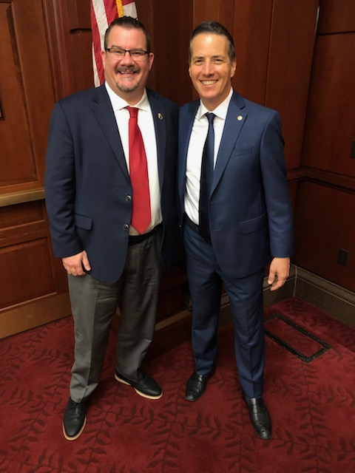
Federal News
Updates from our Executive Director

Slide 30
Announcements
News from Across the State

Slide 31
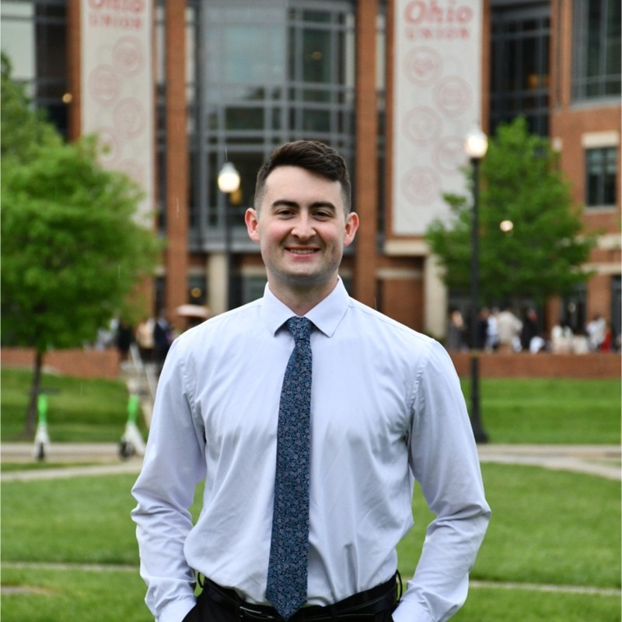
Dayton OH
Interim Chapter Lead in Dayton!
Nathan Halm

Slide 32
Mark Your Calendar…
2025 Annual Meeting
Ohio’s Future, Built By Rail

Slide 33
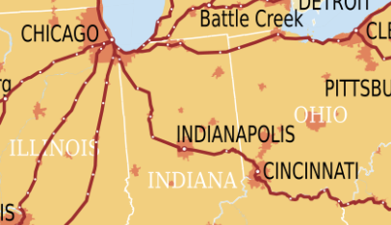
RACE2CHICAGO
Cincinnati
Toledo
Cleveland
Sandusky
Which train arrives to Chi first?
Planning team assembled!
Late July – Exact date announced soon.

Slide 34
Join Our Slack

Slide 35
ALLABOARDOHIO.ORG
ALLABOARDOHIO.ORG
ALLABOARDOHIO.ORG

